Slide 1
TIME’S UP!
GOD’S REIGN IS HERE
MONTE VISTA MUSINGS
A fresh look at the historical Jesus and his impact on the 21st Century

Slide 2


Slide 3
Pew Survey of 35000 Americans over the last 10 years:
Christians have dropped from 78.4 % to 70.6 % of the U.S. population
Over 1/3 of millennials (age 22 to 38) claim no faith affiliation, up 10 %
There are 80 million millenials (age 22-38) in the United States

Slide 4
How Millennials see the church…
How Millennials see themselves…
Judging the world
  Being worldly is bad, while being heavenly is good, church is a haven from the world
Focus on the individual
  People in church seek personal salvation, inner focus
Engaging the world
  The world is where we live – we can choose how we live and what we make of it
Focus on community
  People work out their challenges in collaboration with others

Slide 5
How Millennials see the church…
How Millennials see themselves…
Human beings are sinful, lost
  Human beings are born in sin, fundamentally bad
Vertical spirituality
  Ultimate meaning is to leave the world and get up to God’s heaven to be with Christ our king
Humans are filled with potential
  Human beings are vulnerable, both good and bad, and full of creativity
Horizontal spirituality
  Ultimate meaning is to transform ourselves and the world seeing Jesus as a Godly guide

Slide 6
Mark 1:15 (NRSV)
The time is fulfilled, and the kingdom of God is at hand; repent, and believe in the good news.
Mark 1:15 (The Message)
Time’s up! God’s kingdom (reign) is here. Change your life and believe the Message.

Slide 7
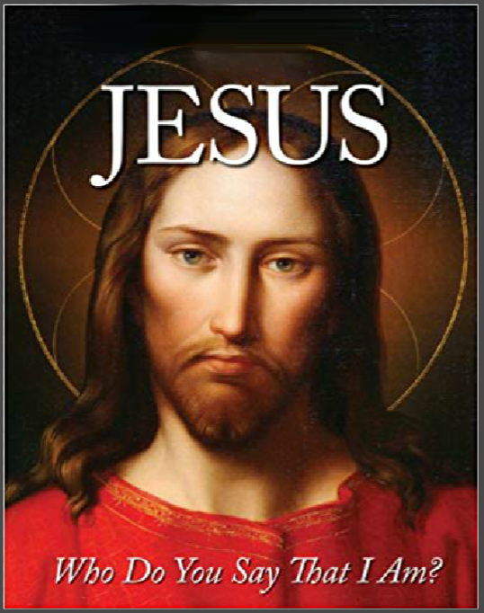
Mark 8:29-31
29 Jesus then asked, "And you - what are you saying about me? Who am I?" Peter gave the answer: "You are the Christ, the Messiah." 30 Jesus warned them to keep it quiet, not to breathe a word of it to anyone. 31 He then began explaining things to them: "It is necessary that the Son of Man proceed to an ordeal of suffering, be tried and found guilty by the elders, high priests, and religion scholars, be killed, and after three days rise up alive."

Slide 8
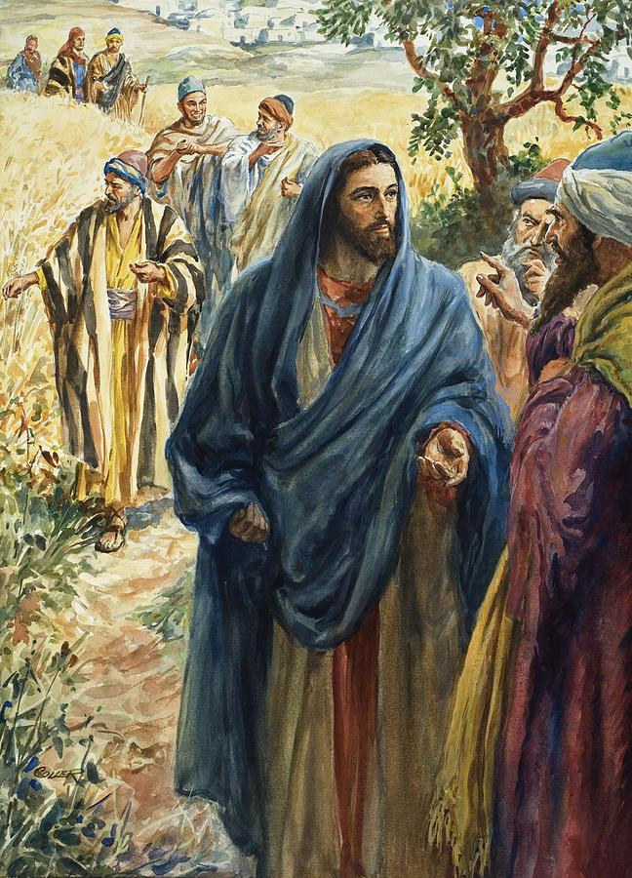
Mark 2:27-28
27 Then Jesus said, "The Sabbath was made to serve us; we weren't made to serve the Sabbath. 28 The Son of Man is no lackey to the Sabbath. He's in charge!"

Slide 9
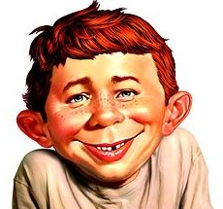
So What?

Slide 10



Slide 11
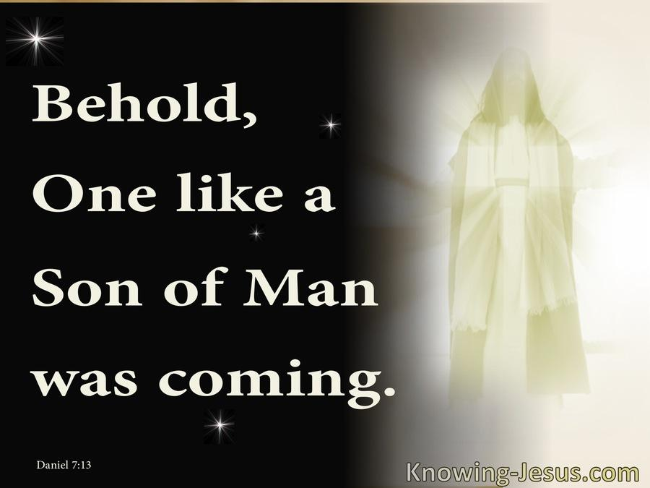
Daniel 7:13-14

Slide 12
Archetypes are innate, universal prototypes or patterns that are present in each of us.
They can be called into our consciousness by stories or experiences that act as triggers.

Slide 13
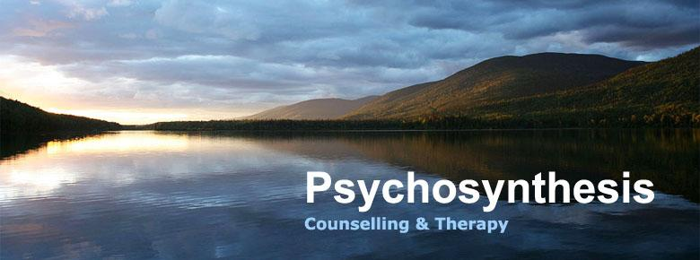

Slide 14
How Millennials see the church…
How Millennials see themselves…
Judging the world
  Being worldly is bad, while being heavenly is good, church is a haven from the world
Engaging the world
  The world is where we live – we can choose how we live and what we make of it

Slide 15
How Millennials see the church…
How Millennials see themselves…
Focus on the individual
  People in church seek personal salvation, inner focus
Focus on community
  People work out their challenges in collaboration with others

Slide 16
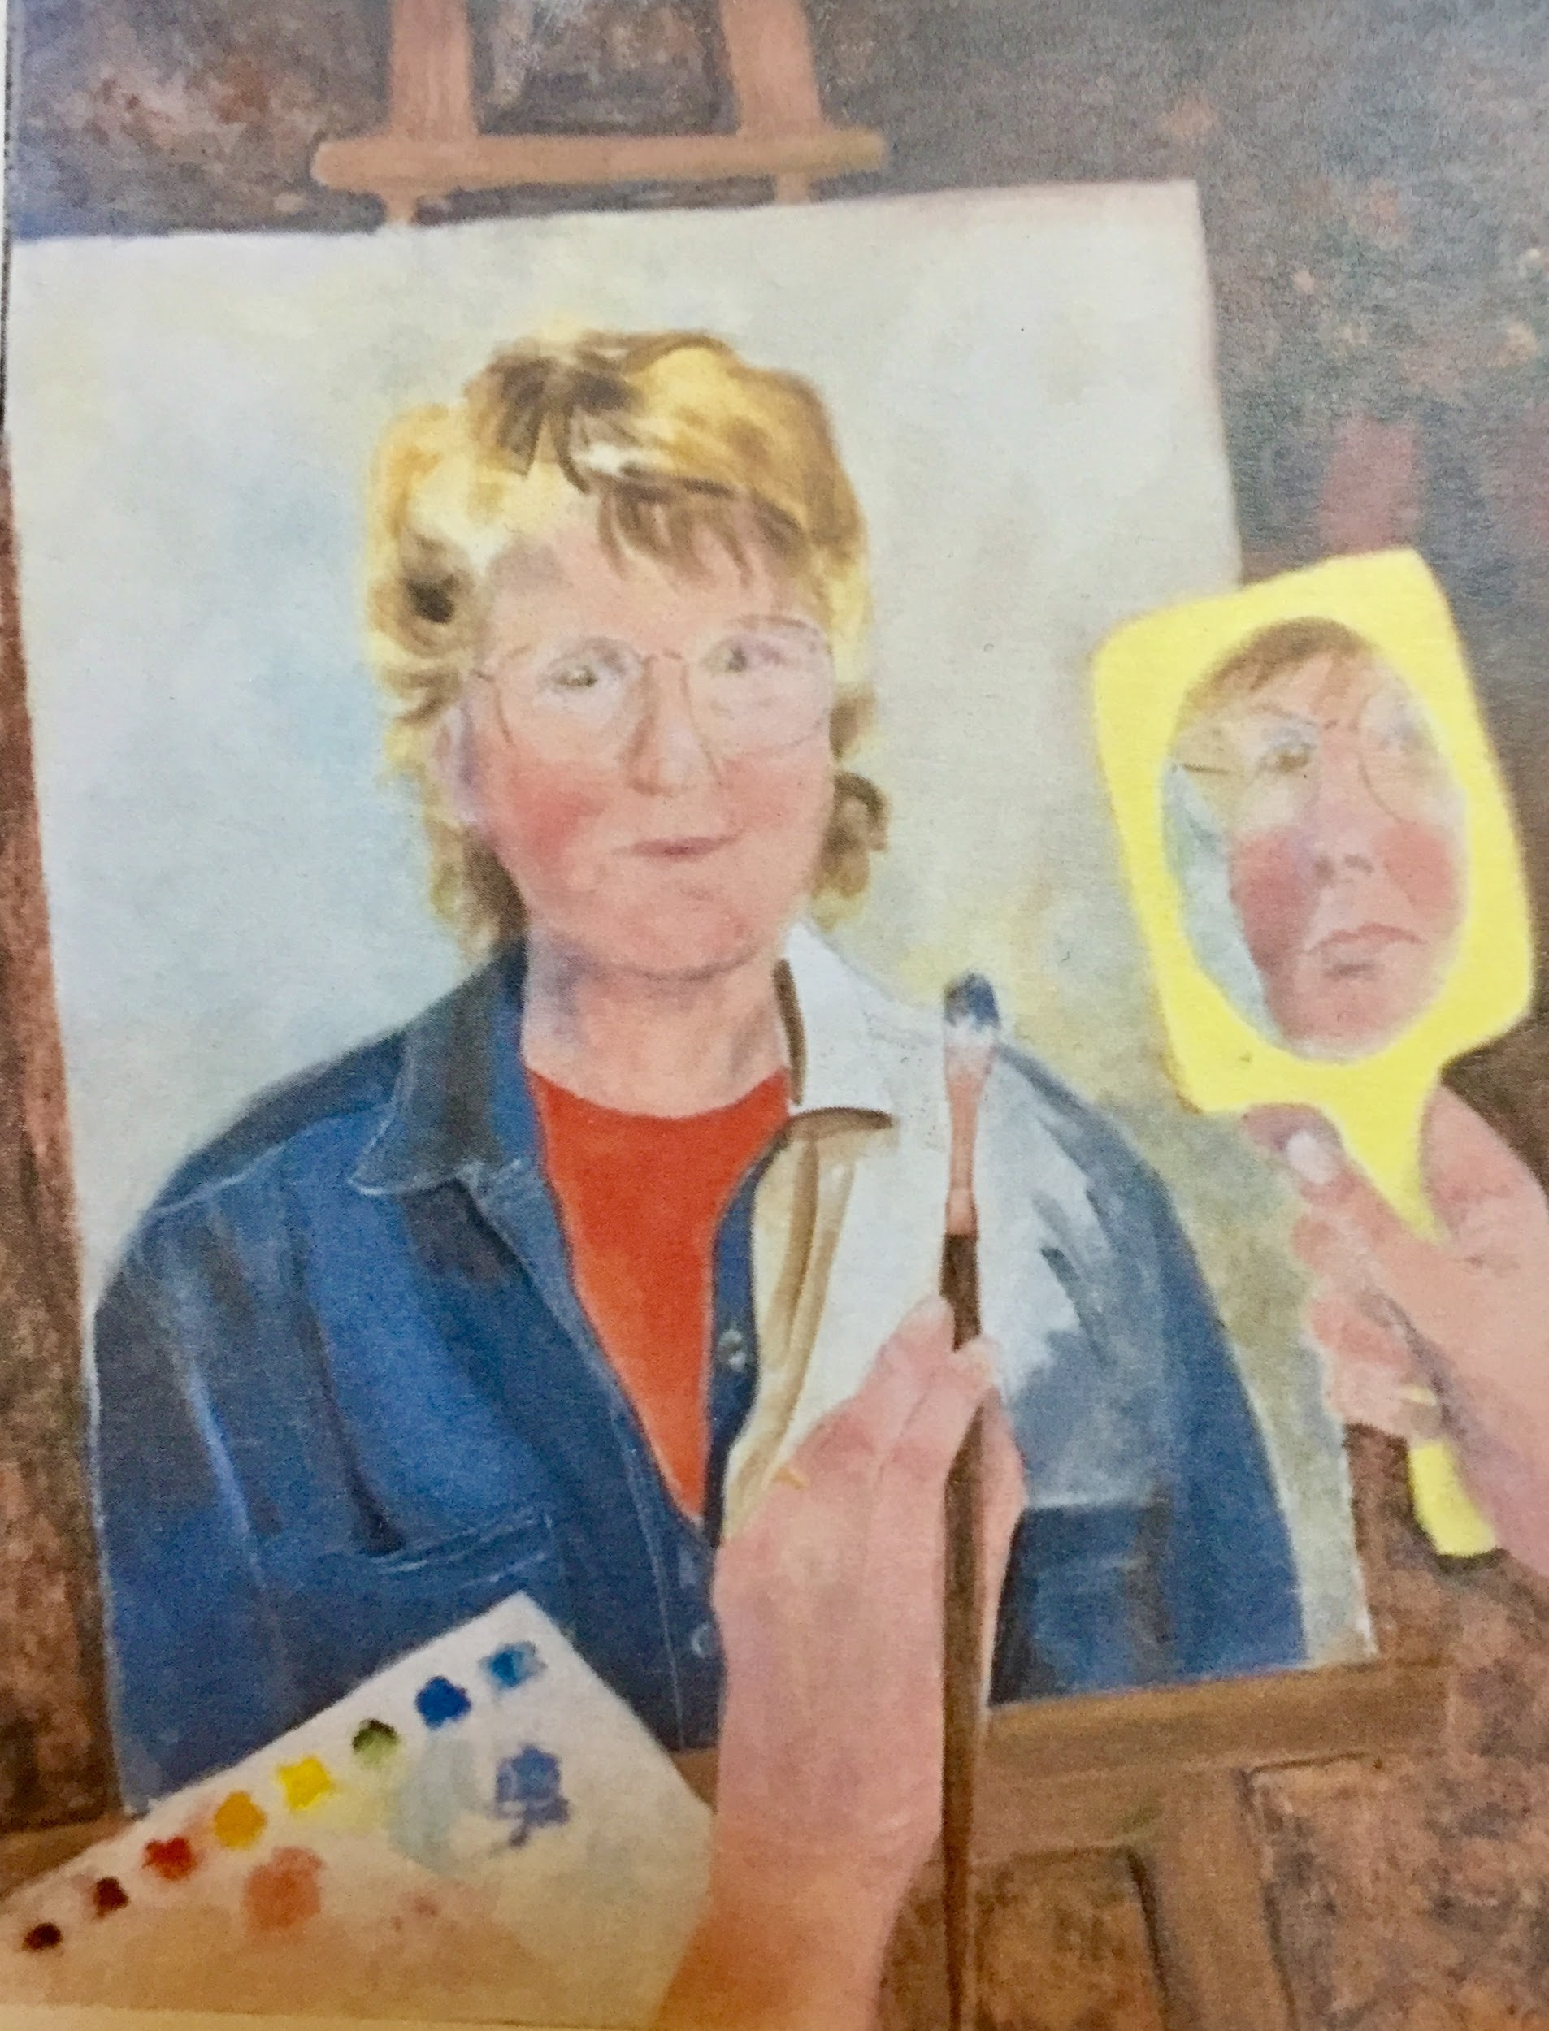

Slide 17
How Millennials see the church…
How Millennials see themselves…
Humans are filled with potential
  Human beings are vulnerable, both good and bad, and full of creativity
Human beings are sinful, lost
  Human beings are born in sin, fundamentally bad

Slide 18
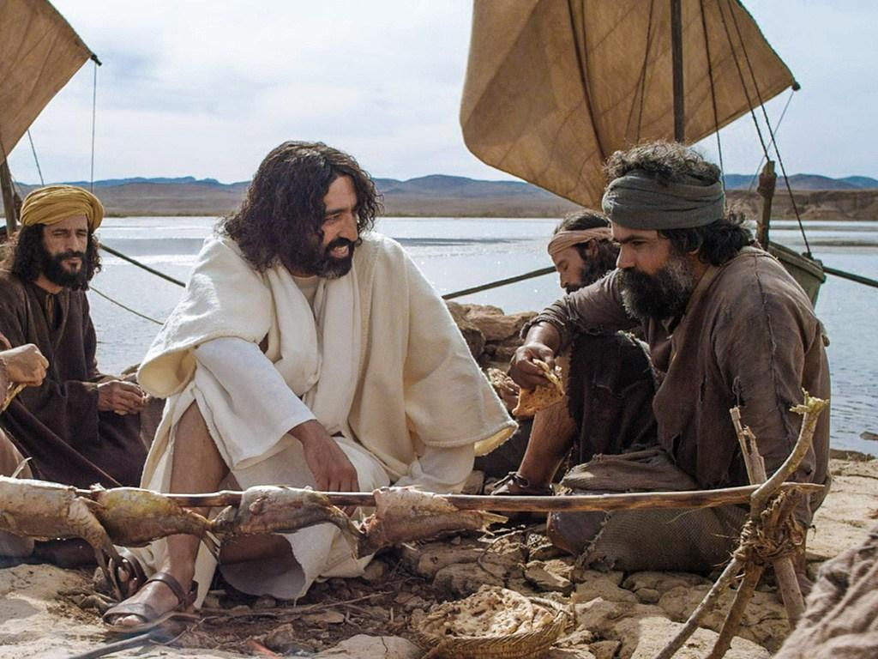

Slide 19
How Millennials see the church…
How Millennials see themselves…
Horizontal spirituality
  Ultimate meaning is to transform ourselves and the world seeing Jesus as a Godly guide
Vertical spirituality
  Ultimate meaning is to leave the world and get up to God’s heaven to be with Christ our king

Slide 20
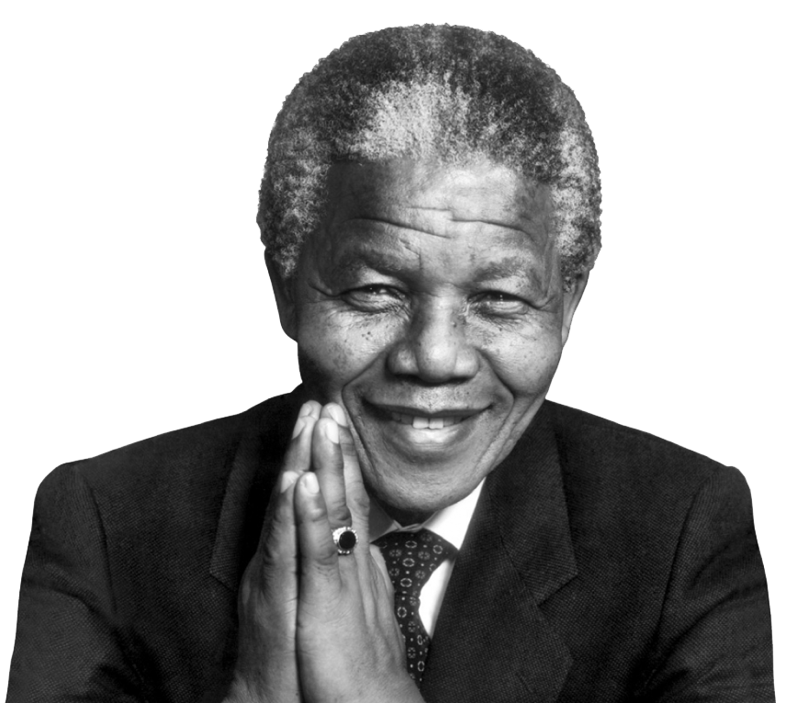

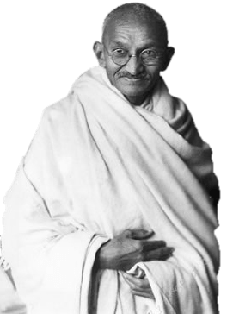
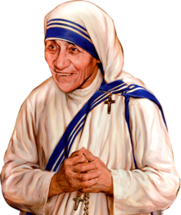

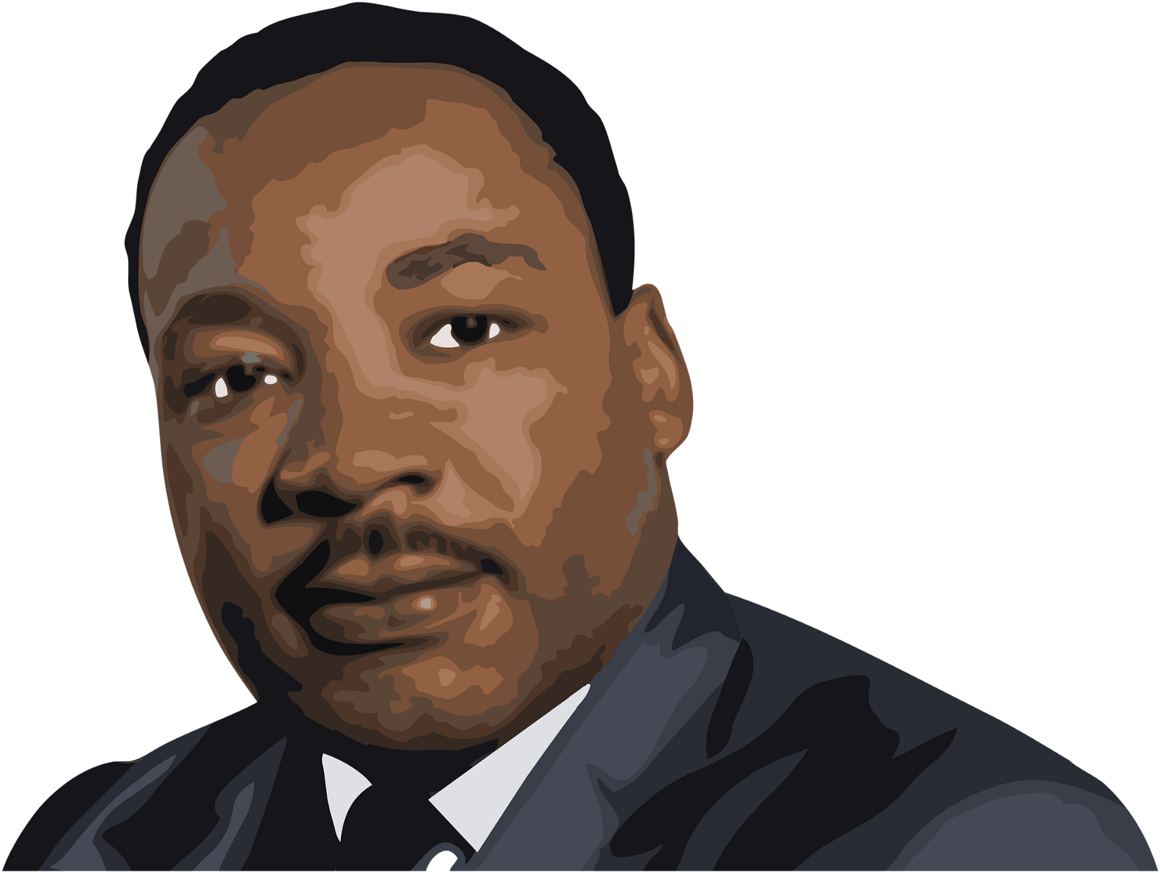

Slide 21
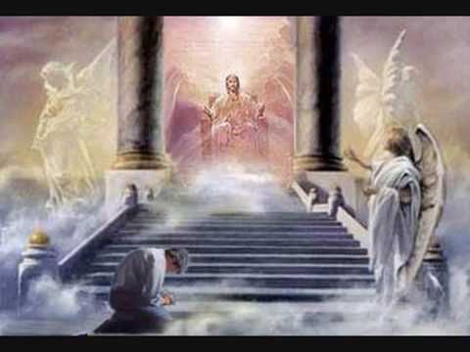
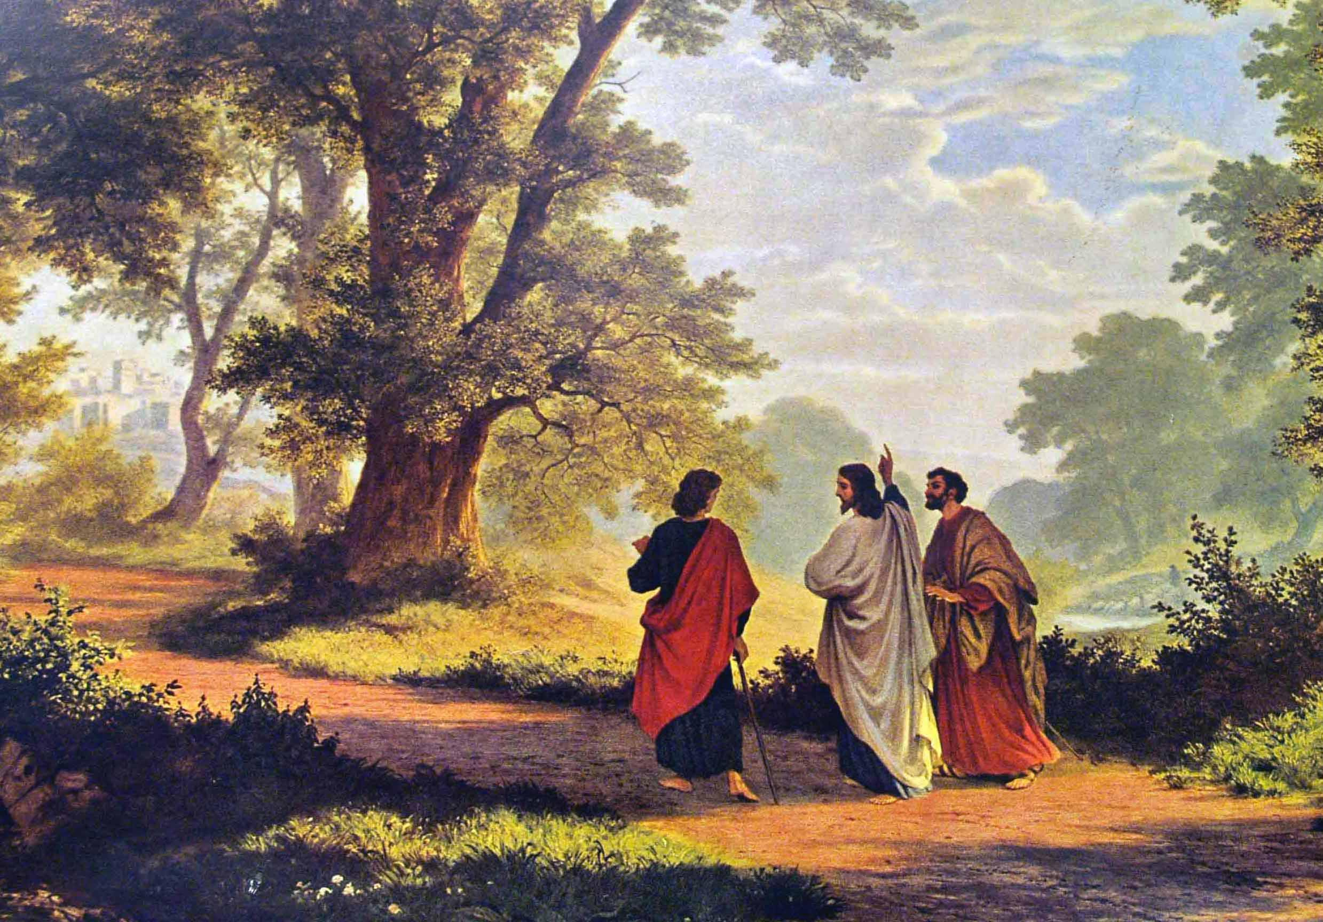

Slide 22
Time’s up! God’s reign is here. Change your life and believe the message.
Are we listening?

